Slide 1
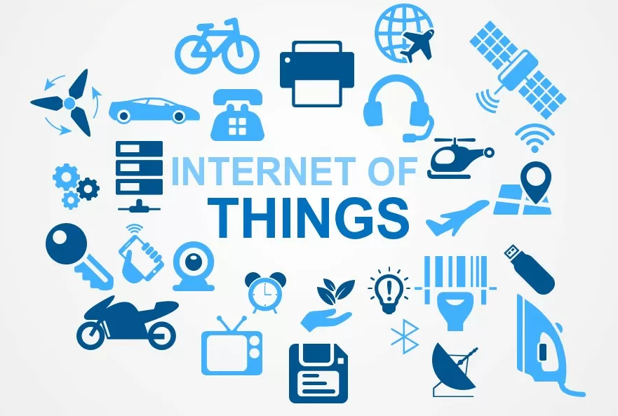

Slide 2
Content
Overview of IoT
History of IoT
Advantages of IoT
Challenges of IoT
Architecture of IoT
Device and network
Application of IoT
IoT tools and platforms

Slide 3
Overview of IoT
Internet of Things (IoT refers toa system of interrelated, interconnected objects that are able to collect and transfer data over a wireless channel without any human intervention.
IoT describes the network of physical objects – “Things” – that are embedded with sensors, software and other technologies for the purpose of collecting and exchanging data with other devices and systems over the internet.
IoT enables to analyze and act on data for decision making applications

Slide 4
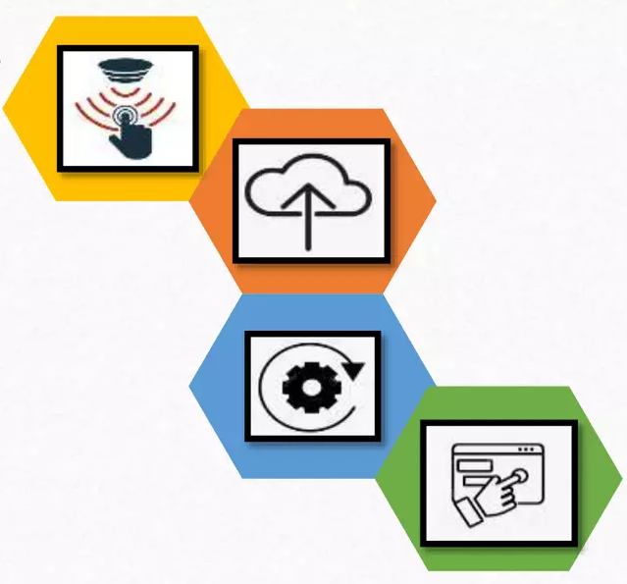
IoT - How it works?
Sensor/Devices
Collecting data
Data processing
Making data useful
Connectivity
Sending data on cloud
User interface
Information delivery

Slide 5
History of IoT
IoT conference was held at Zurich: US National Intelligence Council included IoT as Disruptive Civil Technology
John Romkey: developed a toaster hat turned on and off over the Internet
David Nichols: APRANET-based monitoring
Coke Vending Machine
1989
1999
1982
Tim Berners Lee:
World Wide Web
1990
2008
Kevin Ashton linked RFID in P&G supply-chain to the internet coined term IoT

Slide 6
IoT – Market growth
2025
2020
8 billions
75 billions
2015
7.6 billions
50 billions
2010
7.2 billions
25 billions
Economic Impact:
$2.3 trillions in 2014
to
$7 trillions in 2020
2003
6.8 billions
12.5 billions
6.3 billions
0.5 billions
*CISCO report

Slide 7
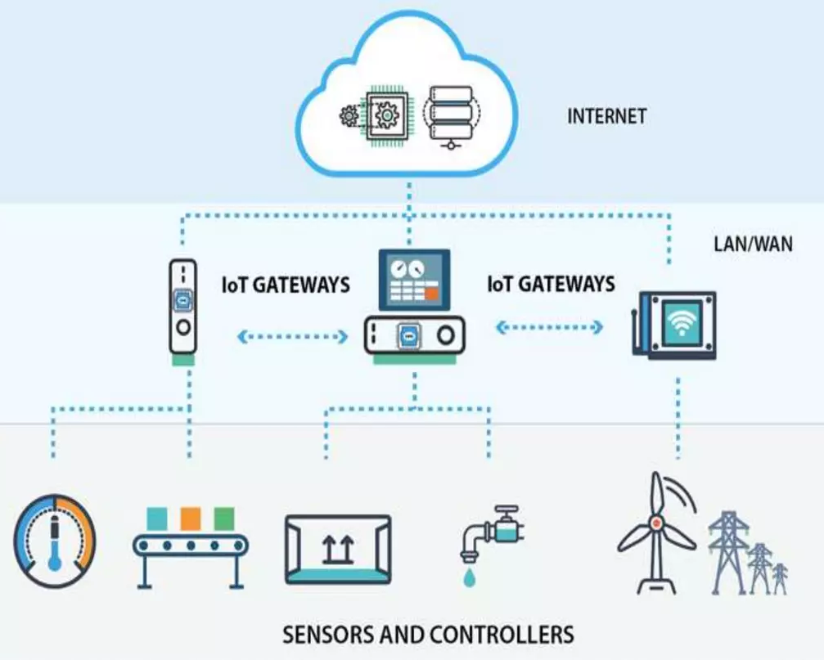
IoT Architecture
Things, Sensors, Controllers
Gateway and data Acquisition
Edge Analytics
Data center and Cloud platform

Slide 8
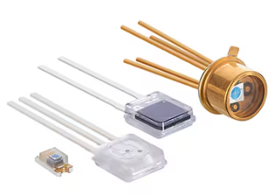
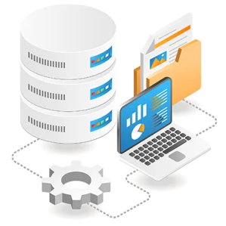

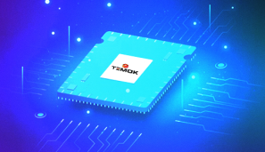
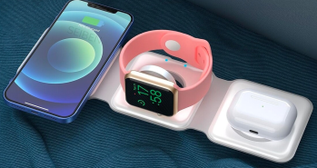
Factors spurring rapid IoT expansion
Falling Sensor cost
Falling Data collection and storage cost
Widely expanding Internet connectivity
Increasing computation power
Increasing smart handheld gadgets

Slide 9


Disadvantages of IoT
Security Network Attacks
Complexity Design and Deployment
Privacy and confidentiality

Slide 10
Applications of IoT
Remote Monitoring
Predictive Maintenance
Facilities Management
Manufacturing Efficiency
Connected products-supply chain management
Smart Home, buildings and offices
Precision agriculture
Healthcare
Defense

Slide 11
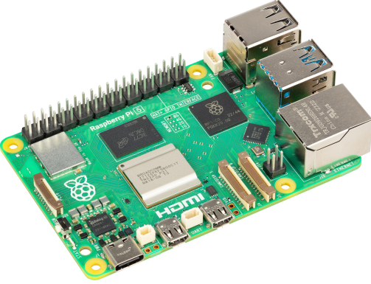
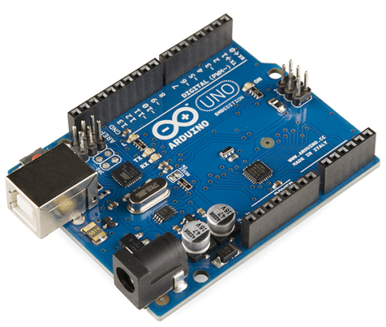
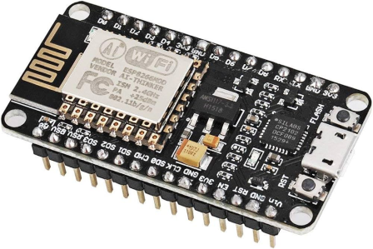
IoT Tools
Raspberry Pi
Arduino
ESP

Slide 12
Thank You

